Slide 1

Item/doc 8.2(1-7) –
WIGOS Measurements
Third Session of the Infrastructure Commission
(INFCOM-3, 15-19 April 2024)
Jane Warne/Chair SC-MINT
16 April 2024

Slide 2
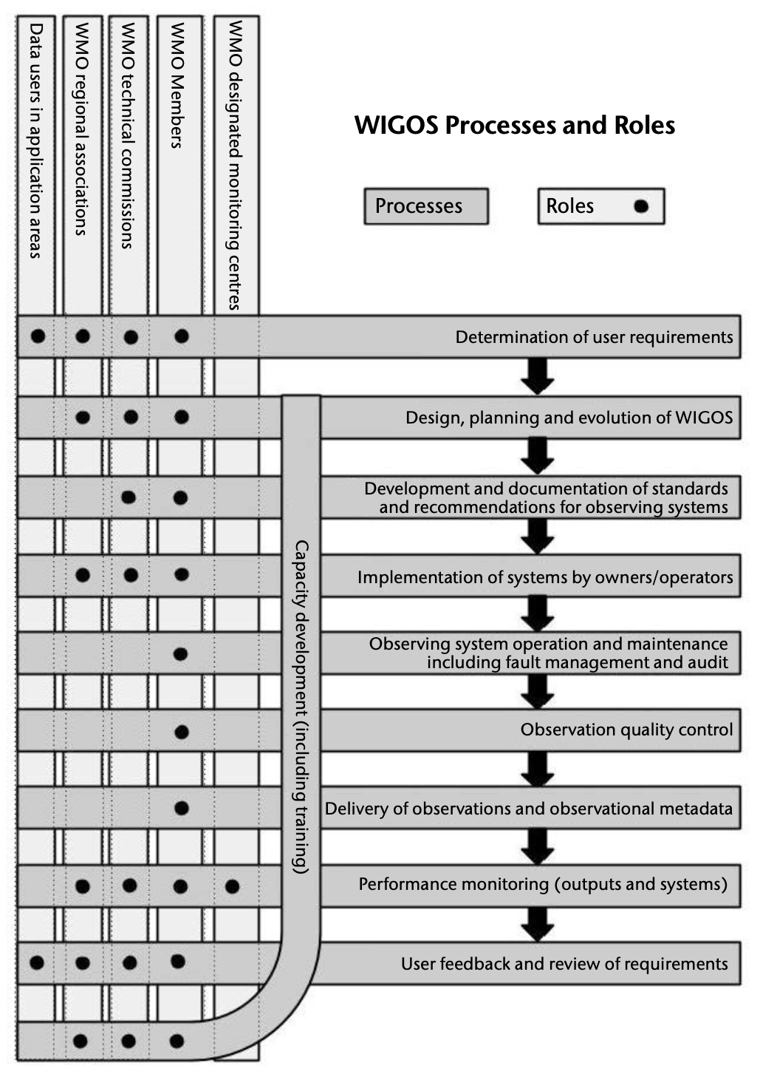
WIGOS Processes and Roles
Members
& partners
SC-ON
Requirements
Design
SC-MINT
Standards / best practice
Implementation
Quality
SC-IMT
Delivery
Monitoring
Feedback/review
Capacity development
WIGOS Manual (WMO No.-1160)

Slide 3


Standing Committee on Measurements, Instrumentation and Traceability (SC-MINT)
Main role of SC-MINT:
Promote world-wide comparability of measurements
Ensure measurements are fit-for-purpose, and of known quality
Activities include:
Provide guidance to support changing user requirements;
Promote innovation and the application of emerging technologies, techniques and integrated solutions in measurement;
Develop and maintain effective standards, other regulatory and guidance material related to instrumentation and measurement practices;
Provide guidance on the traceability of measurements to international standards, and quantifying the uncertainties of the measurements;
Conduct instrument intercomparisons;
Develop education and training material on measurements, instrumentation and traceability;
Collaborate with SC-ON, SC-IMT and HMEI to ensure measurement solutions and practices are both practical and constructively contribute to Members needs

Slide 4
Documents submitted to INFCOM-3
Already APPROVED as non-debate documents:
Doc 8.2(1) - Guide to Instruments and Methods of Observation (WMO-No. 8)
Doc 8.2(3) - Guide to Operational Weather Radar Best Practices (WMO-No. 1257)
Doc 8.2(4) - Update of the Guide to Hydrological Practices (WMO-No. 168)
Doc 8.2(5) - Guidelines for Radiometer Comparisons
To be discussed now:
Doc. 8.2(2) - Envolvement of the operational measurement uncertainty requirements
Doc 8.2(6) - Future instrument intercomparisons
Doc 8.2(7) - Upper-air instrument intercomparison follow-up

Slide 5
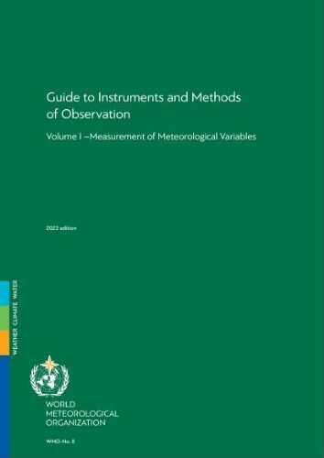

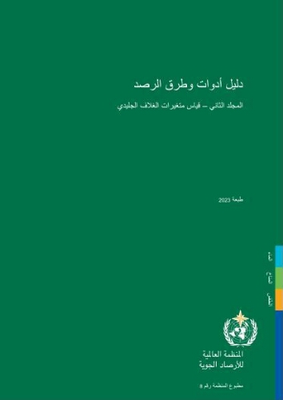
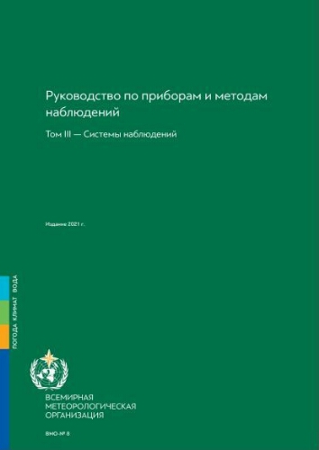
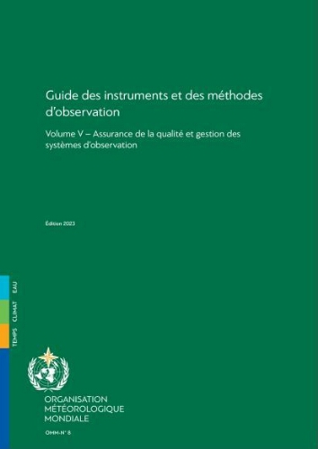
8.2(1) Update of the Guide to Instruments and Methods of Observation (WMO-No. 8)
Already APPROVED as non-debate document
Chapters that were updated for the 2024 Edition:
Major revision of Volume I, Chapter 6 “Measurement of precipitation”
Partial revision of Volume I, Chapter 7 “Measurement of radiation”
Minor revision of Volume II (Measurement of cryospheric variables), Chapter 1 “General”
New chapter on the measurement of permafrost, Chapter 4 in Volume II
Minor revision of Volume III, Chapter 5 “Special profiling techniques for the boundary layer and the troposphere”
Notes:
Recognized as the main source of information used by Members to standardize instrument performances and ensure the quality of observations,
Constantly reviewed and regularly updated by the relevant expert teams of SC-MINT
Available in all WMO languages in the WMO library
Ch6: precipitation: Full revision
Ch7: radiation: inclusion of guidelines for radiometer comparisons and traceability of terrestrial radiation
Vi.-II, Ch4: Completely new chapter on measurement of permafrost

Slide 6
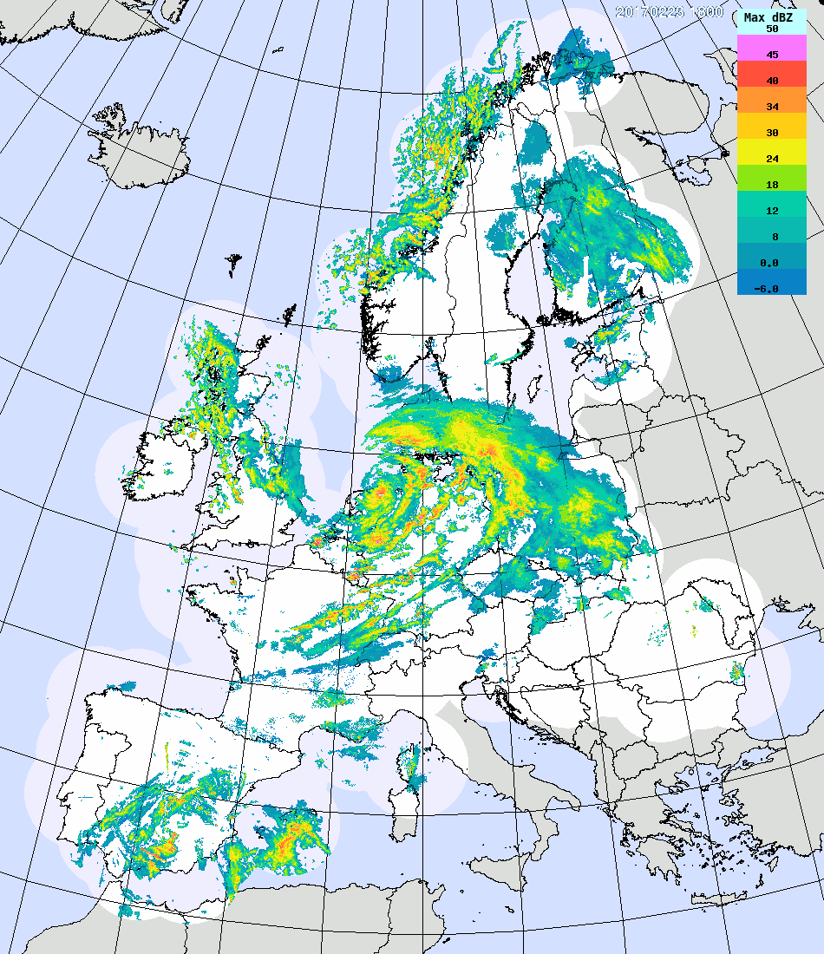
8.2(3) Update of the Guide to Operational Weather Radar Best Practices (WMO-No. 1257) Already APPROVED as non-debate document
Background:
The Guide to Operational Weather Radar Best Practices (WMO-No. 1257) has been developed by the INFCOM Joint Expert Team on Operational Weather Radars (JET-OWR) with the aim to provide an important source of guidance material on various aspects of the operational weather radars.
It also provides complementary and supportive guidance on radar-related material already available in other WMO guides, such as in WMO-No. 8.
Eight volumes:
  I. “Weather Radar Network Program Design” – Published in 2023 Ed
  II. “Weather Radar Technology” – Published in 2023 Ed
  III. “Weather Radar Procurement” – Published in 2023 Ed
  IV. “Weather Radar Siting, Configuration, and Scan Strategies” - NEW
  V. “Weather Radar Calibration, Monitoring, and Maintenance” - NEW
  VI. “Weather Radar Data Processing “- NEW
  VII. “Weather Radar Data Representation and International Exchange.”
  – Published in 2023 Ed
  VIII. “Operational Weather Radar Glossary of Terminology” - Outstanding
Notes:
3 new volumes

Slide 7
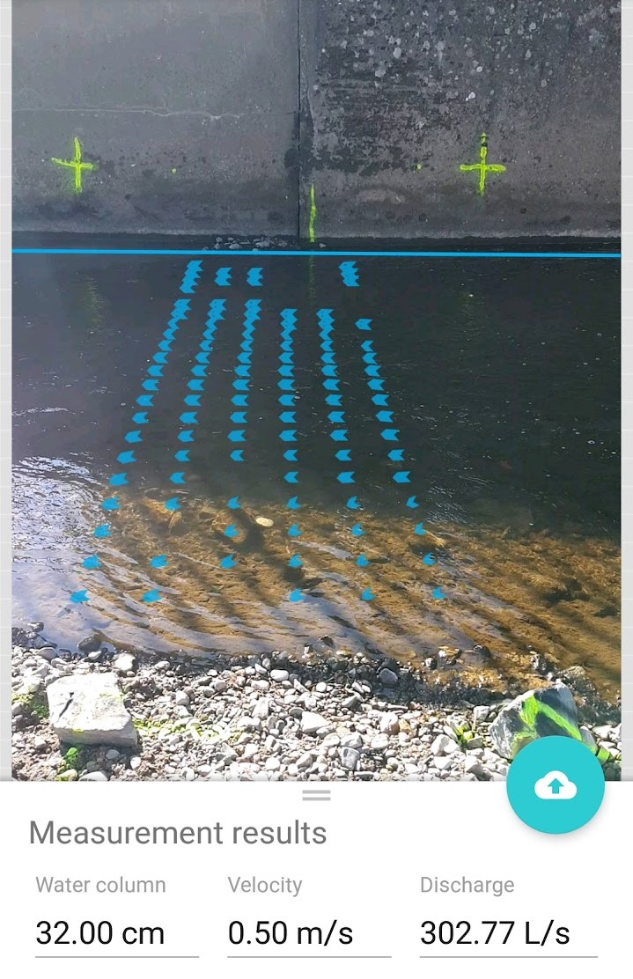
8.2(4) Update of the Guide to Hydrological Practices (WMO-No. 168) Already APPROVED as non-debate document
The Guide is recognized by Members as the main source of information on recommended practices
Update process:
Minor update: New section on “Image-based methods for discharge measurement”
Proposals developed by JET-HYDMON and SC-HYD, and reviewed by SC-MINT Project X and Editorial Board.

Slide 8
8.2(5) Guidelines for Radiometer Comparisons
Already APPROVED as non-debate document
Background:
WMO defined radiometric references to which Members’ instrument are traceable.
SC-MINT Expert Team on Radiation References developed guidelines to foster comparability and transparency of the procedure followed during radiometer comparisons.
The guidelines were included in the update of the Guide to Instruments and Methods of Observation (WMO-No. 8) approved earlier this week.
Particularly important in the context of an expected change of radiation references that may happen at the next World Meteorological Congress
Future:
SC-MINT to promote use of those guidelines in future intercomparison
The World Radiation Centre and Regional Radiation Centres should follow these guidelines when organizing next radiometer comparisons.
Notes:
A fundamental activity of SC-MINT is to undertake intercomparisons.
In this period two have been undertaken
The first is radiometry and the second in upper air obs
Considering variability and impacts of (duration, environmental conditions, sampling, metadata, management of intercomparison database)
Applicable to different methodologies like profilers
The

Slide 9

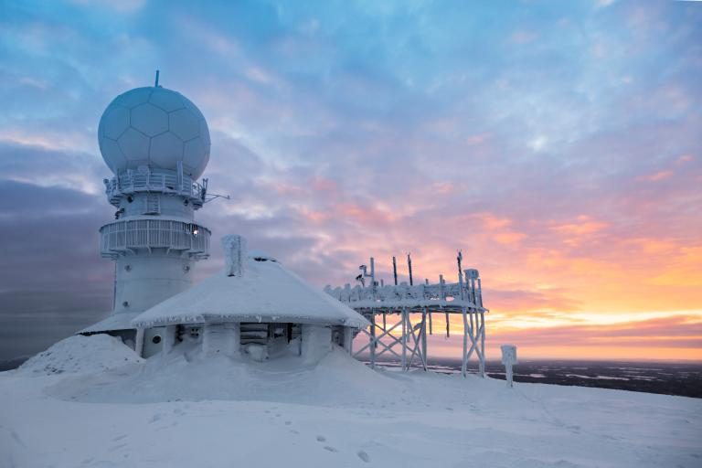
TECO-2024
WMO Technical Conference on Meteorological and Environmental Instruments and Methods of Observation (TECO-2024) with the theme: “Measurements and new technologies for WMO priority initiatives.”
  Vienna, Austria, from 23 to 26 September 2024
In conjunction with Meteorological Technology World Expo organized by UKi Media & Events, from 24 to 26 September 2024
A circular letter announcing the conference and call for abstracts was sent on 7 March 2024
Online abstract submission is open until 30 April 2024
All information available on the conference website:
https://wmo.int/site/teco-2024
Credit:Imaggeo / Angelo Odetti
Credit: Adobe Stock / ronstik

Slide 10
Documents submitted to INFCOM-3
Already APPROVED as non-debate documents:
Doc 8.2(1) - Guide to Instruments and Methods of Observation (WMO-No. 8)
Doc 8.2(3) - Guide to Operational Weather Radar Best Practices (WMO-No. 1257)
Doc 8.2(4) - Update of the Guide to Hydrological Practices (WMO-No. 168)
Doc 8.2(5) - Guidelines for Radiometer Comparisons
To be discussed now:
Doc. 8.2(2) - Envolvement of the operational measurement uncertainty requirements
Doc 8.2(6) - Future instrument intercomparisons
Doc 8.2(7) - Upper-air instrument intercomparison follow-up

Slide 11
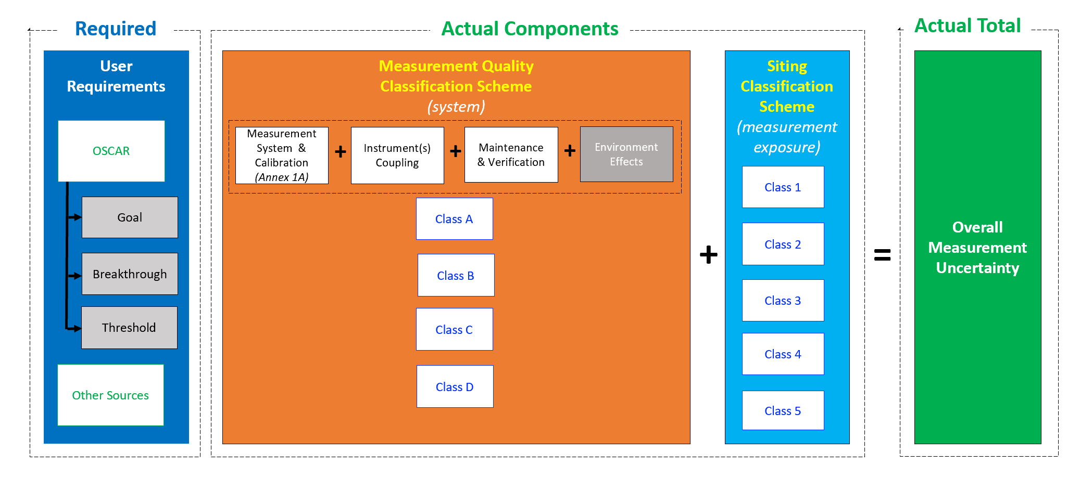
8.2(2) Evolvement of the operational measurement uncertainty requirements (WMO-No. 8, Vol.I,Ch1,Annex 1A)
Class A: Aligned with OSCAR/Requirements “goal” level;
Class B: Aligned with OSCAR/Requirements “breakthrough” level;
Class C: Aligned with OSCAR/Requirements “threshold” level;
Class D: Greater than the uncertainty for Class C, or no information available

Slide 12
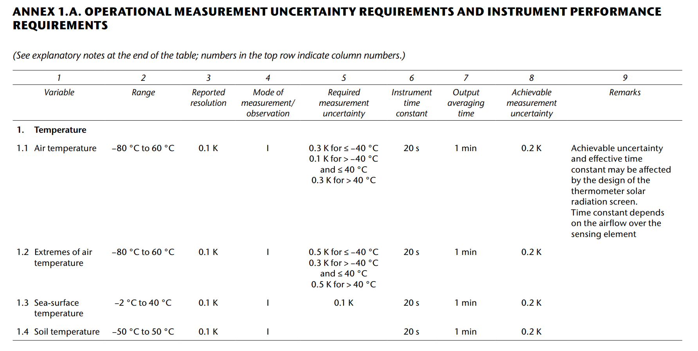
8.2(2) Evolvement of the operational measurement uncertainty requirements (WMO-No. 8, Vol.I,Ch1,Annex 1A)
User requirements – now provided in OSCAR/Requirements
Typical operational performances
This table was frequently wrongly used for procurements.
Proposal is to replace it with something more suitable.

Slide 13
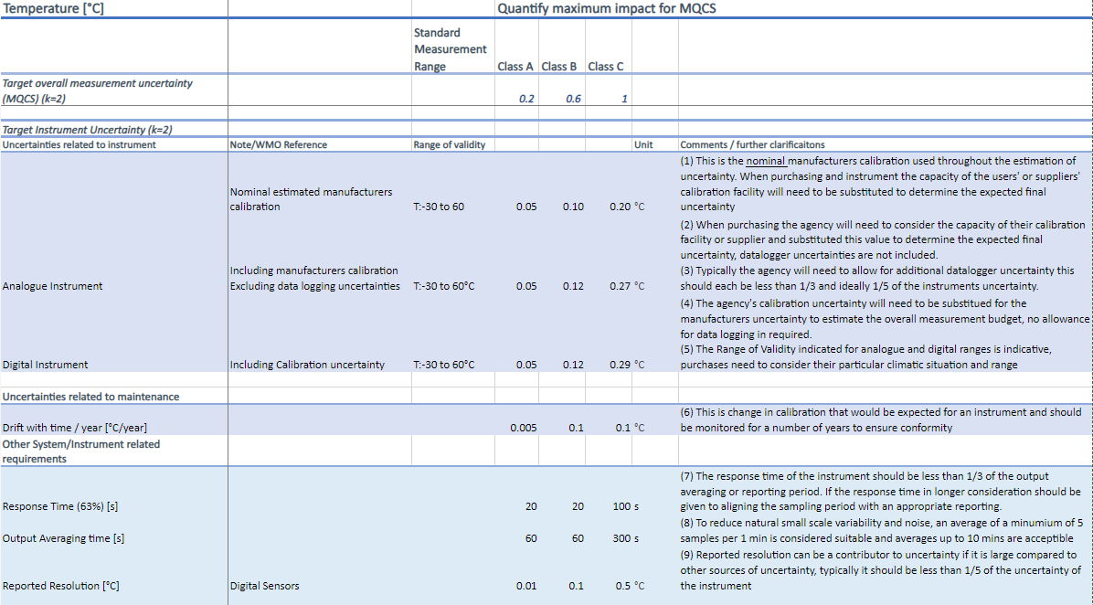
8.2(2) Evolvement of the operational measurement uncertainty requirements (WMO-No. 8, Vol.I,Ch1,Annex 1A)
Sample of new Annex 1A Guidance

Slide 14
8.2(2) Evolvement of the operational measurement uncertainty requirements (WMO-No. 8, Vol.I,Ch1,Annex 1A)
Proposed decision:
To endorse the proposal for this new approach to guidance on Operational measurement uncertainty requirements and instrument performance requirements (WMO-No. 8, Vol I, CH 1, Annex 1.A) into a comprehensive scheme that will be aligned with the Measurement Quality Classifications for Surface Observing Stations on Land, and will ensure unambiguous and interpretable linkages to the OSCAR/Requirements;
To task SC-MINT to continue the evolvement as proposed, and lead the development of an appropriate tool, possibly within OSCAR database, to accommodate the new scheme.

Slide 15
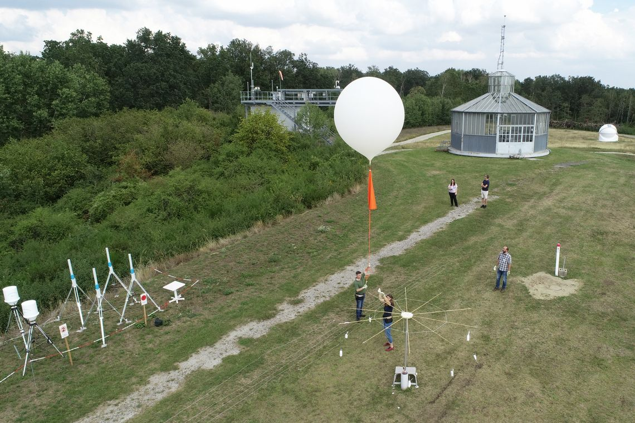
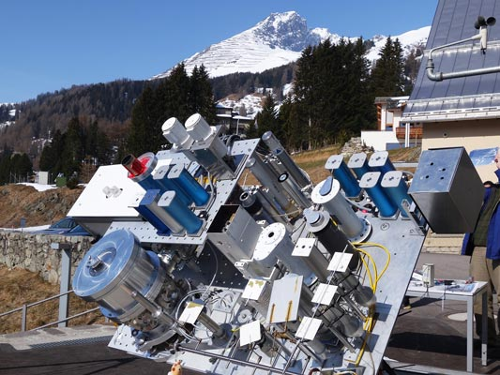
8.2(6) Future instrument intercomparisons
Background:
Instrument intercomparisons are important to assess performance of instruments
Several instrument intercomparisons were proposed by experts.
Global instrument intercomparisons require large amounts of resources. Very challenging to organize several intercomparisons at the same time.
Need for prioritization based on relevance of topic, ability of potential leads, and availability of resources.

Slide 16
8.2(6) Future instrument intercomparisons
Call to Members:
To share procedures related to testing of Automatic Weather Stations (AWSs), in particular of all-in-one AWSs
To conduct experiments related to the implementation of the Siting Classification for Surface Observing Stations on Land (quantify the impact of obstacles) and share challenges experienced with classification
To publish results of instrument intercomparisons performed at national level
To consider hosting future WMO instrument intercomparisons
Requests SC-MINT:
To reviewing the detailed plans/concept notes for instrument intercomparisons
To develop guidelines for the intercomparison of all-in-one AWSs that could be later applied by Members in conducting a distributed intercomparison of all-in-one AWSs
To prioritize intercomparisons

Slide 17

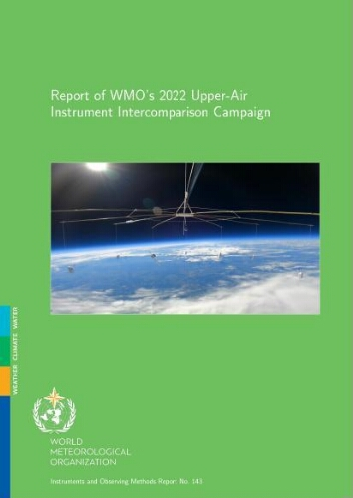
8.2(7) Upper-air instrument intercomparison follow-up
Report of WMO 2022 Upper-Air Instrument Intercomparison Campaign is published.
Co-lead by German Weather Service and MeteoSwiss
Methodology:
  Radiosonde and remote-sensing instruments
  Included a laboratory and a field phase for radiosondes
  Independent radiosonde operators
  Use of GRUAN data products (well characterized uncertainties) as reference
  Performance assessed against user uncertainty requirements published in OSCAR/requirements for several application areas
  Transparent methodology (code published)
Database available for further studies

Slide 18
8.2(7) Upper-air instrument intercomparison follow-up
Background:
Report of WMO 2022 Upper-Air Instrument Intercomparison Campaign has just been published.
The report includes several recommendations to WMO, Members and manufacturers.
Proposed decisions:
Invites instrument manufacturers to follow-up recommendations for improvements of upper-air observing systems as provided in the intercomparison report (e.g. calibration of humidity sensors, time lag behavior of humidity at low temperatures between -40°C and -85°C), and to continue their efforts to reduce the environmental impact of those systems,
Urges SC-ON to ensure that the OSCAR requirements include clear references on their justification and on how they were derived

Slide 19
8.2(7) Upper-air instrument intercomparison follow-up
Proposed decisions (continued):
Request INFCOM:
To develop an update of WMO-No. 8 based on intercomparison findings
To facilitate the access to existing radiosonde codes and attribution of codes to newly developed radiosonde systems
Invites Measurement Lead Centres, in collaboration with INFCOM:
To help in verifying the correctness of BUFR data generated by new radiosonde systems
To consider hosting future upper-air instrument intercomparisons, building on the experience gained through this intercomparison

Slide 20

Thank you.
^{wmo.int}

